Slide 1
Upenn Robocup Locomotion
Tutorial 1

Slide 2
Agenda
Personal Background
History of Our Locomotion System
Plan for Redevelopment
Understanding New System

Slide 3

About Me
Junior and triple major in CIS, EE, and MEAM. Also
submatriculating into robotics.
Joined the team Freshman year, and have been
involved with Locomotion since then
Ambitious – I expect our locomotion system to
outperform every team at the global competition
next year

Slide 4
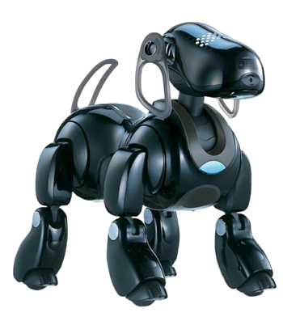
History of our locomotion system
Team’s original code base was developed in 1999
for the Sony Aibos
In 2009 we transitioned to the Standard Platform League,
which uses the Alderbaran Nao humanoid robot
Old code base includes many vestiges of old system
(the system was never entirely replaced)
Since then, incremental changes have been made with modest
results

Slide 5
Identified problems with old system
Lack of modularity
Poor documentation
Outdated gait implementation
Lack of closed loop feedback

Slide 6
Plan for redevelopment
Derive physics behind state-of-art gait (Completed in Fall 2015)
Build C++ system that implements unidirectional gait (Completed in Summer 2016)
Update system to support omnidirectional walking
Incorporate parameter optimization (Machine learning, PSO, etc.)
Implement closed loop feedback
Develop dynamic kicking and getup motions

Slide 7
System architecture

Slide 8
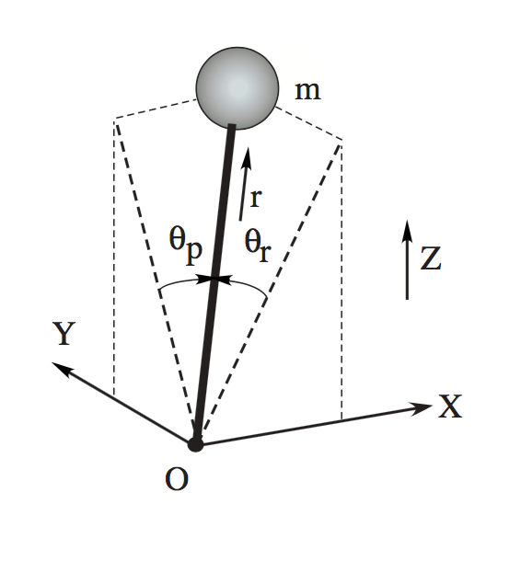
Linear inverted pendulum (LIPM)
Robot motion is modeled using an inverted pendulum,
with the point mass representing the robot’s center of
mass (COM).
Model accounts for Cartesian forces acting on COM
as well as torques about thetaR and thetaP.

Slide 9
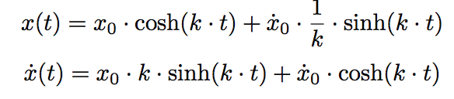
LIPM (Contd.)
Position and velocity of COM can be solved for from first law equations, while applying some constraints / simplifications:
COM resides in horizontal plane (ignore floor incline)
Ignore input torques (only care about effect of gravity)
Resolves to the following equations:

Slide 10
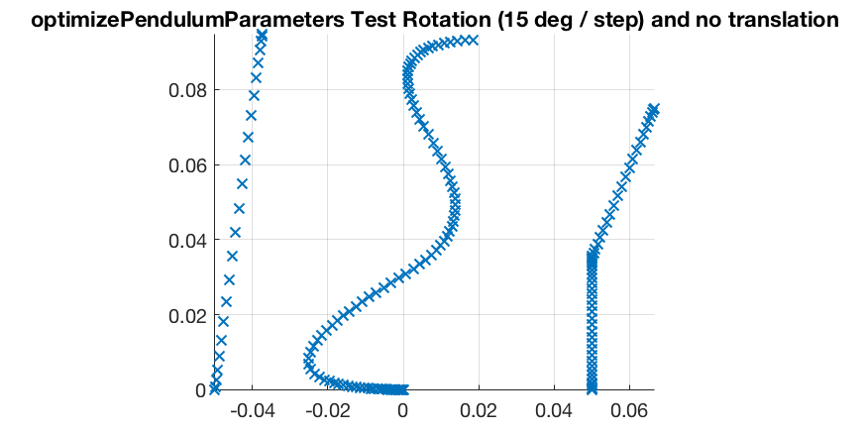
Visualization of equations

Slide 11
From equations to motion
Select starting LIPM parameters (x0Pos, x0Vel, y0Pos, y0Vel)
For first phase, compute equation start time.
Generate Bezier curve trajectory for pre-first-step motion.
System operates concurrently for remaining duration of gait:
Trajectory for next step
Using position / velocity matching in x direction, compute end time of next step and start time of next next step.
Using position / velocity matching, determine pendulum parameters for next step
Execution of current step motion

Slide 12
Ways to get involved
Parameter Optimization
Closed-Loop Feedback
Implementation of B-Human Walk

Slide 13
Thanks For coming!
Contact Information:
Austin Small
215-896-5169
austinsmall326@comcast.net

